Slide 1
Market in NetLogo
Jordi Bonet Valiente
Clara Rivadulla Duró

Slide 2
Index
Introduction
Motivation and description of the simulated system
The interaction protocols
The interface's design
Experiments and results
Analysis and conclusions
Future work

Slide 3
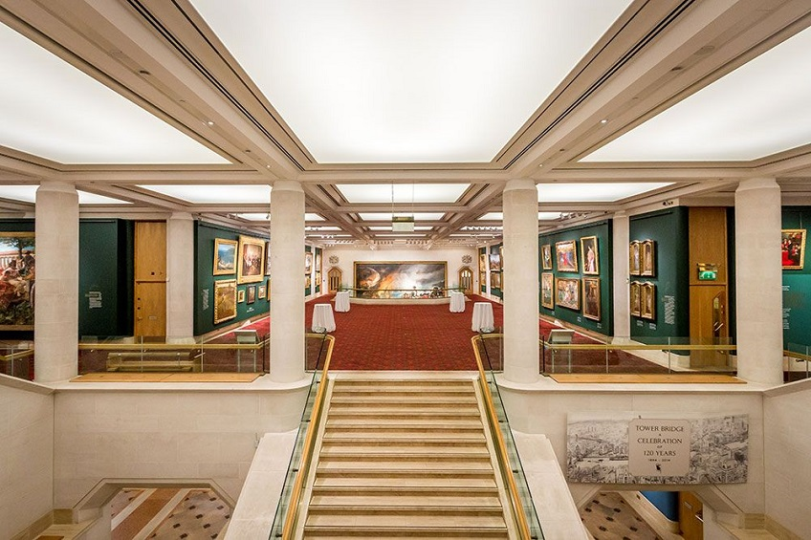

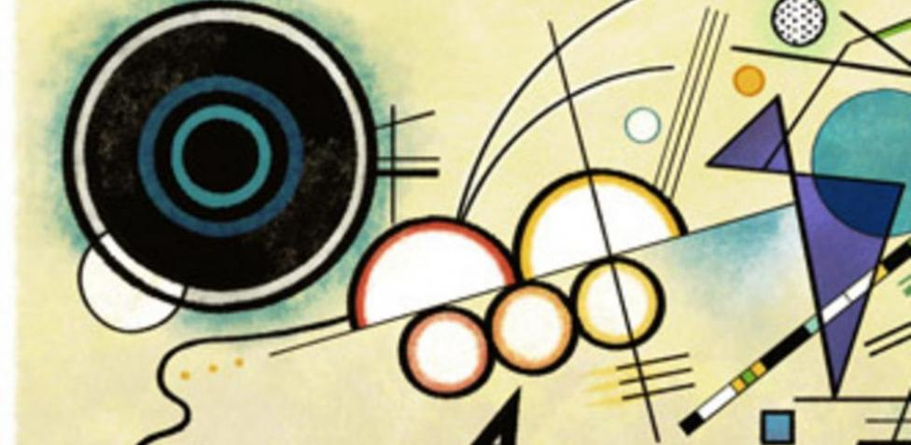
Introduction
We have decided to model our market as a commerce transaction between art galleries and collectors, where the sold / bought products are paintings.

Slide 4
Motivation and description of the system
Which market?
Art (paintings).
Which agents?
Art galleries (of Madrid and Albacete) and collectors (1, 2, 3, 4).
How should agents interact with each other?
Talking and negotiating in a bilateral way (peer to peer).

Slide 5
Interaction protocols
We have designed our communication protocol depending on the success or the failure of the advertisement presented by the art gallery.
Advertisement attributes in order to compare them with customer’s preferences: author and price.
Example:

Slide 6
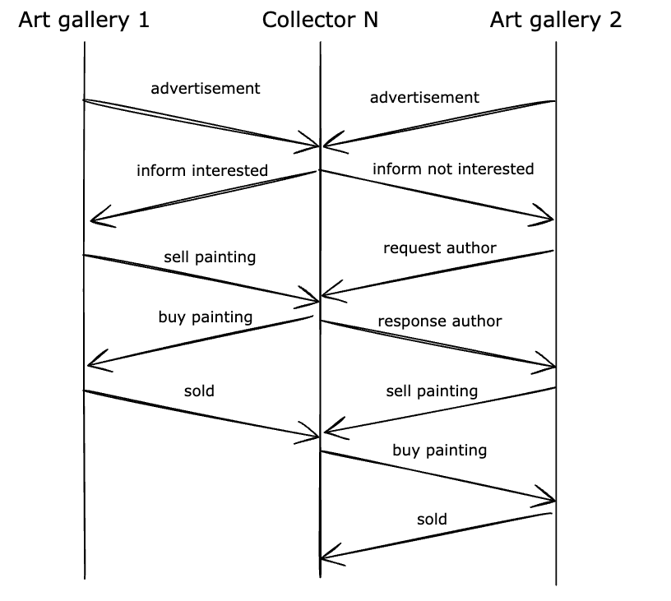
Interaction protocols
This diagram represents the optimal cases of our communication protocol, where the collector

Slide 7
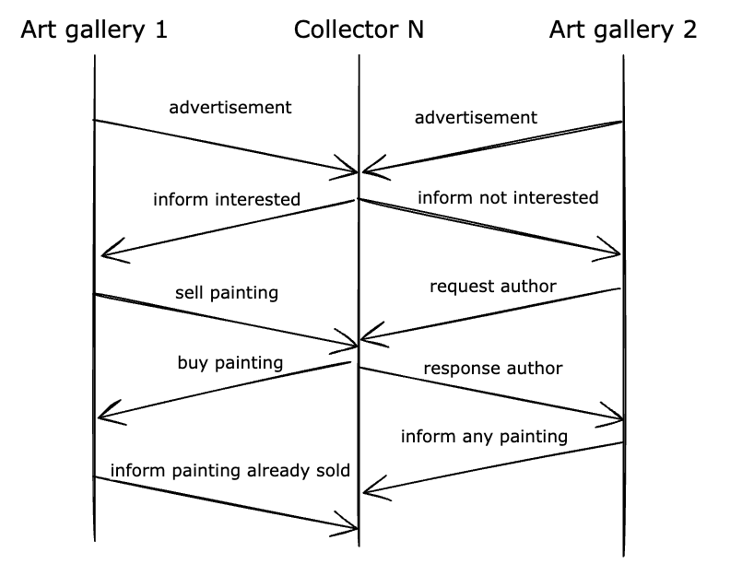
Interaction protocols
This diagram represents the worst cases of our communication protocol, where the collector N is interested in a painting from one of the galleries and not interested in the other’s.
However, when proceeding with the purchase of the painting from the art gallery they’re interested in, the painting has already been sold.
In the meanwhile, the second art gallery has requested the collector’s favourite painters in order to inform him about any painting by that author they have available.

Slide 8
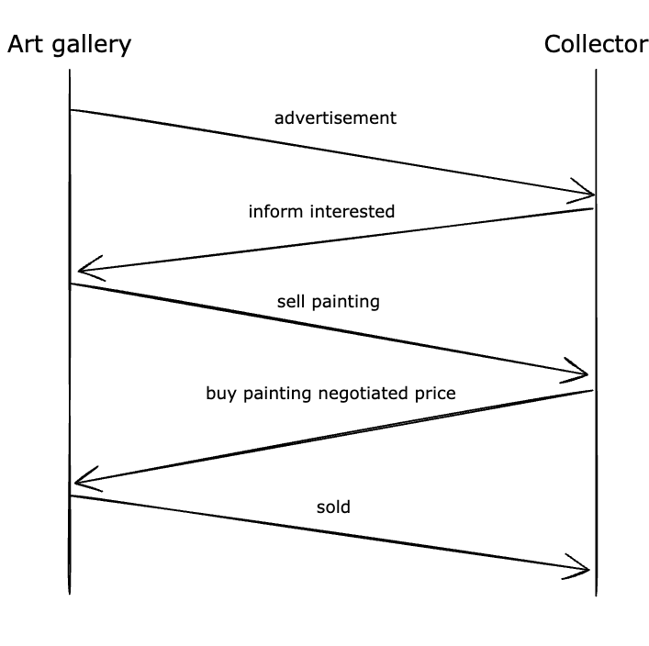
Interaction protocols
This diagram represents the negotiation between the art gallery and the collector:
The art gallery sends an advertisement to the collector. Then, the collector sends a response informing that they’re interested in the painting.
Once they’ve negotiated, the art gallery sells the painting to the collector, who buys it at the accorded price.
Finally, the painting has been sold.

Slide 9
Interaction protocols
In the first scenario, we consider that the collector is already interested in the gallery’s advertisement, so its description matches with the collector’s preferences. Once the collector has received the advertisement, the collector sends a feedback message to the gallery informing about their interest in the advertised painting. Then, the negotiation starts and the costumer ends up buying the painting.

Slide 10
Interaction protocols.
In the second scenario, the collector isn’t interested in the gallery’s advertisement because the painting doesn’t match with his preferences. So, after receiving the advertisement, the customer sends a feedback message to the gallery letting them know they aren’t interested. Consequently, the gallery asks for the costumer’s preferences and returns a filtered catalogue, of which the collector selects one favourite painting. Finally, the negotiation starts and the costumer ends up buying that painting.

Slide 11
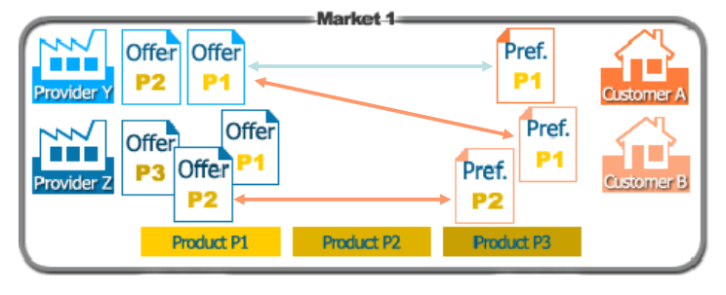
Interface design
We based our interface design on the theory slides of the subject.

Slide 12
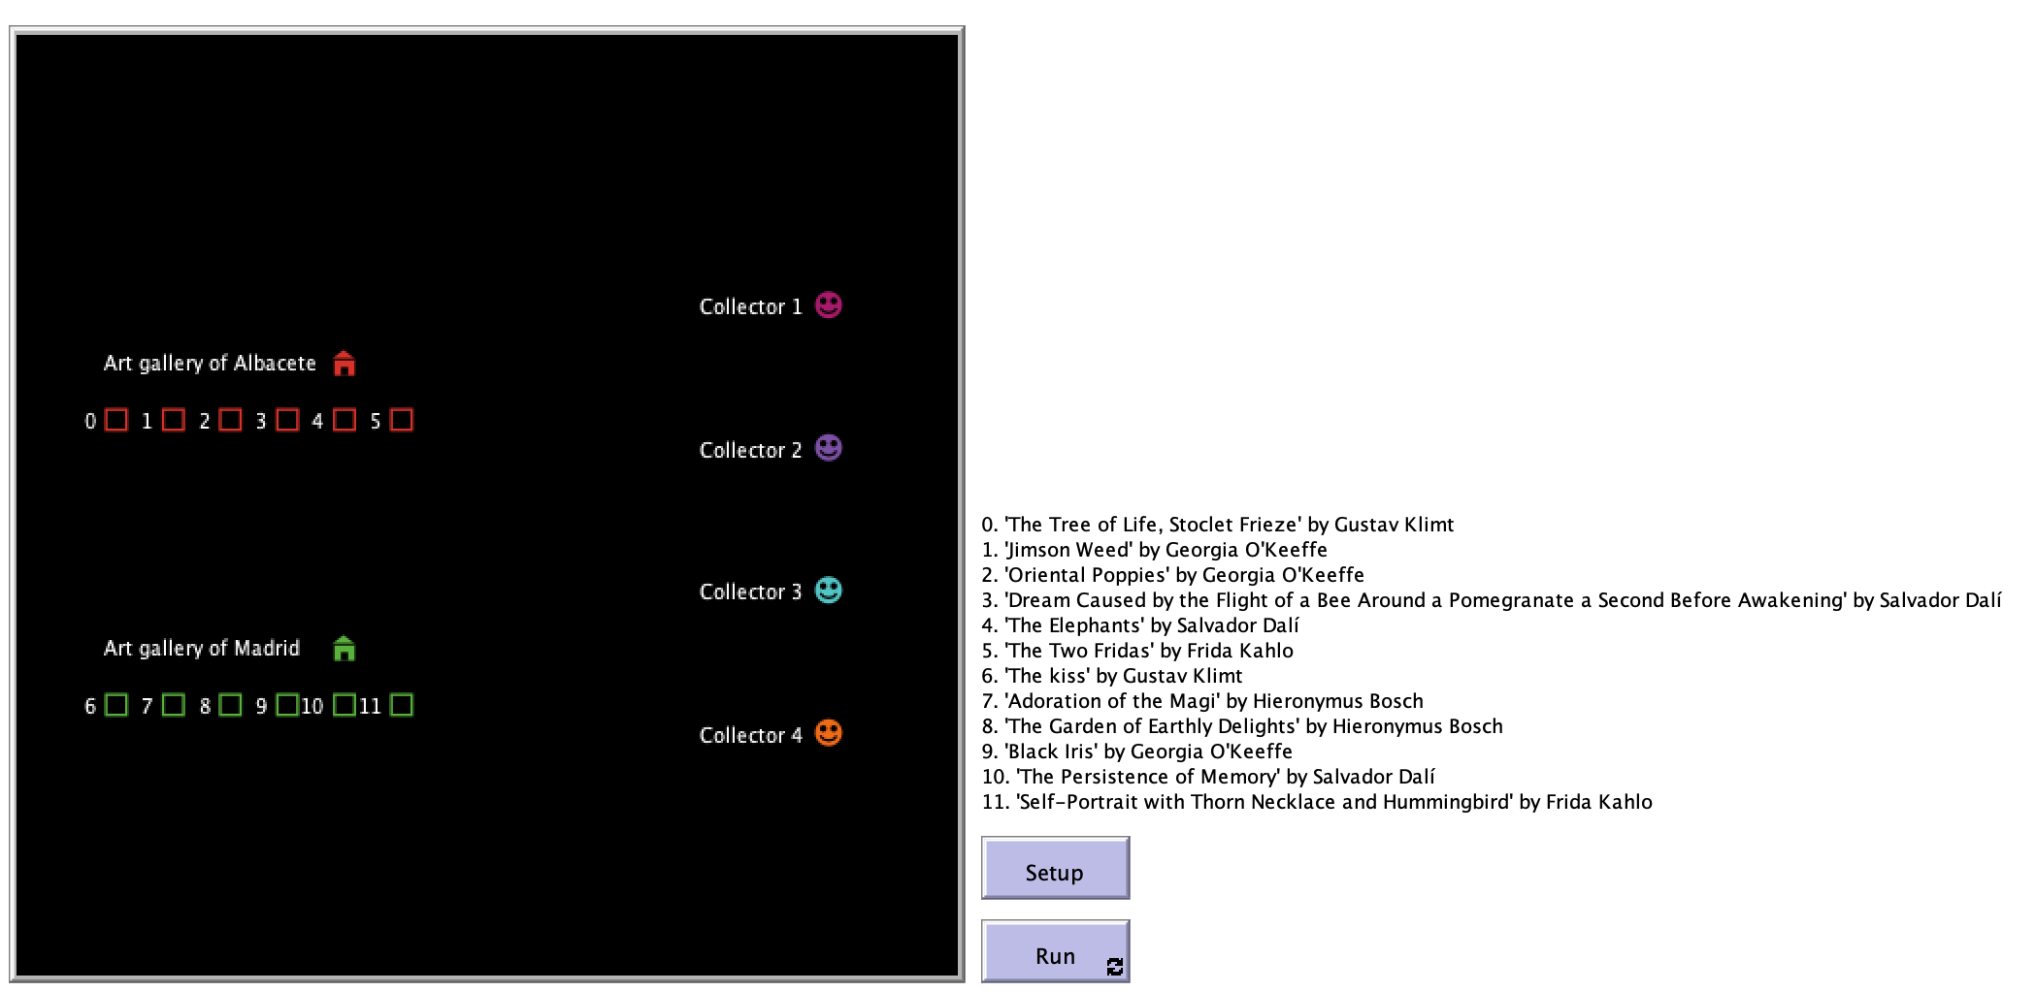
Interface design. Simulating the negotiation

Slide 13
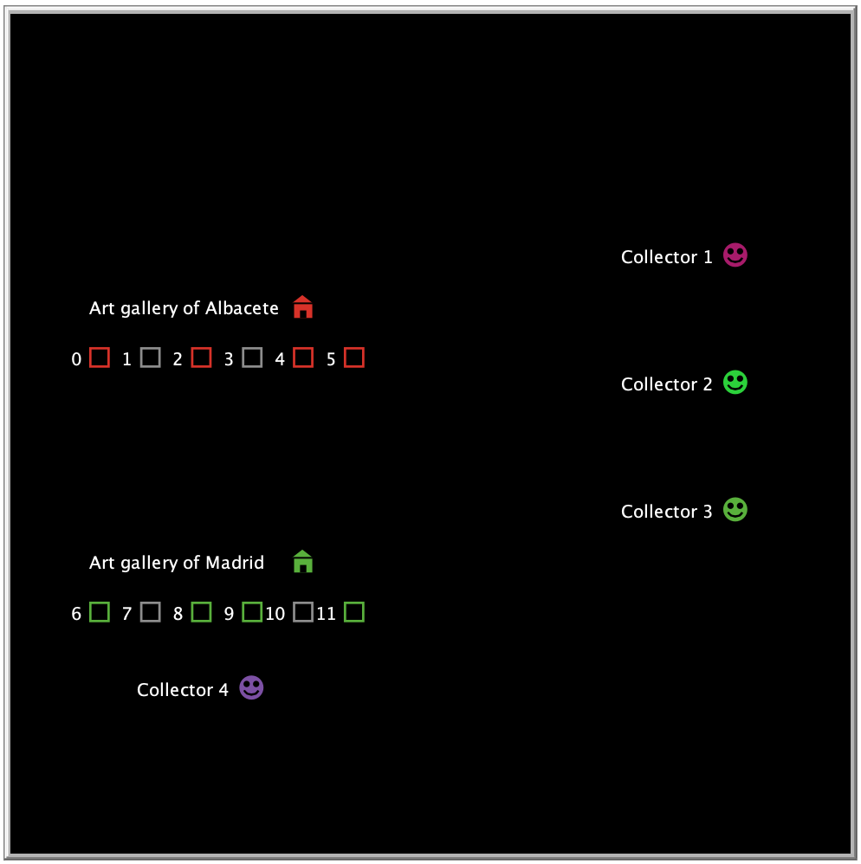
Interface design. Galleries, paintings and collectors
Each gallery is represented by a house icon (red or green) on the left, and their paintings are represented by squares (again, red or green).
Each collector, which are represented by the smiling faces on the right, moves to the gallery where the painting they’re interested in is.
Once they’re there, the collector and the gallery start dialoguing in order to make a fair deal. If the result is a sold, the costumer gets the painting (and its corresponding square is turned grey).

Slide 14
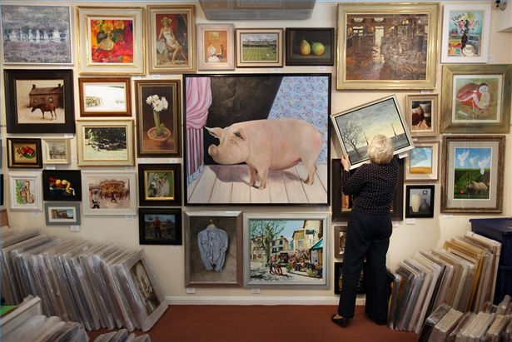
Experiments and results
We have based the tests on the variation in the number of collectors.

Slide 15
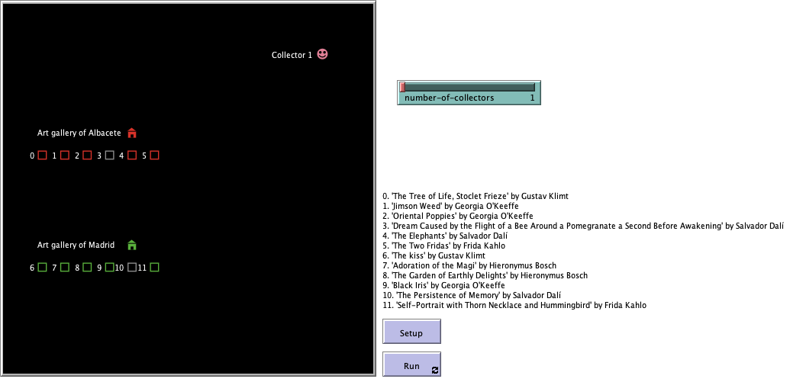
Experiment with one collector
Each collector can get as maximum two paintings, because there are two art galleries that contact with them.

Slide 16
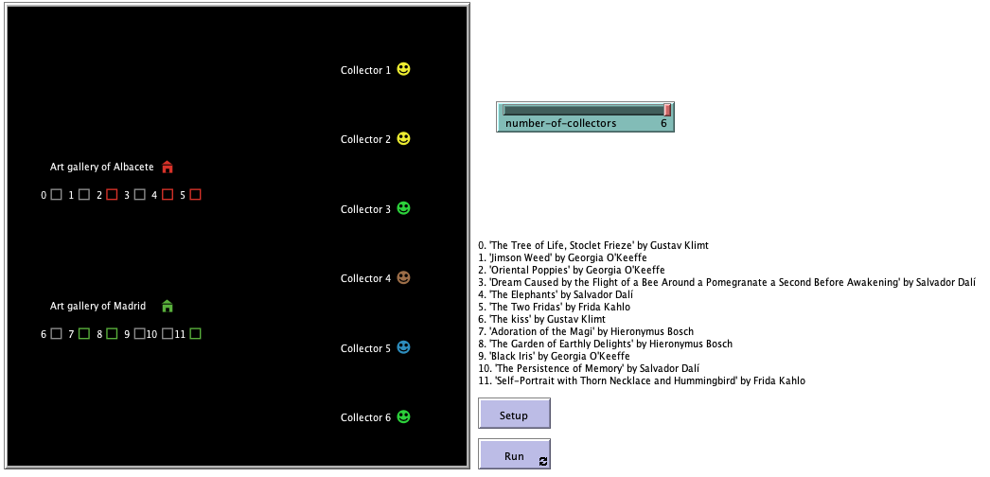
Experiment with six collectors
More collectors means more probability to sell paintings, which means better performance of the market.

Slide 17

Analysis and conclusions
The global behaviour matches with our expectations.
With these simulations we have learned the importance of reaching the maximum number of clients in a market and matching their preferences to the products you have.
In conclusion, the performance of our market is higher when there are more collectors.

Slide 18
Future work

